Slide 1


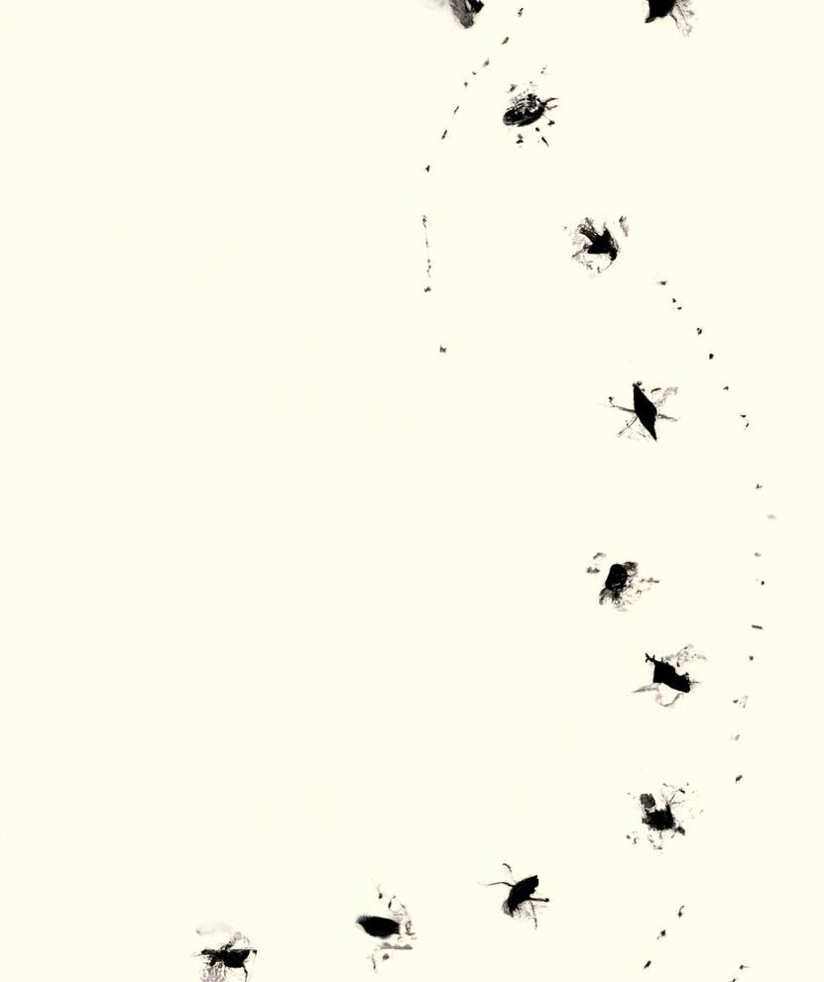
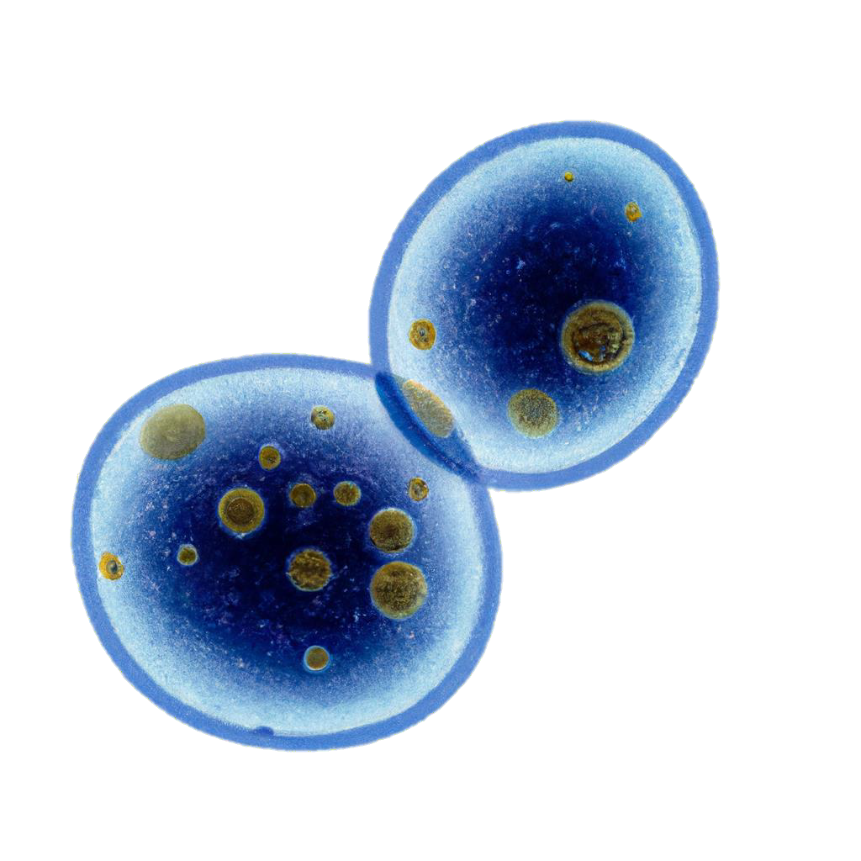

Unravelling Sex-Specific Aging on Flies: A Deep Learning Approach
Presented by Nikolai Tennant,
Researcher at Ritambhara Singh's Lab
Brown University & IISAGE

Slide 2
METHODOLOGY
01.
Exploratory Data Analysis (EDA)
Analyzing the Fly Atlas transcriptomics
dataset (head cells only) to reveal initial
patterns.
03.
Model Building
Creating and optimizing a 1D
Convolutional Neural Network to
discern sex-specific aging patterns
RESEARCH OBJECTIVE: DEVELOP A PIPELINE TO PREDICT SEX_AGE
02.
Data Preprocessing
Preparing and transforming raw data into a format fit for the 1D CNN model
04.
Model Evaluation/Visualization
Evaluating the model's performance using performance metrics, feature importance (SHAP, LIME), and general statistical analysis.

Slide 3
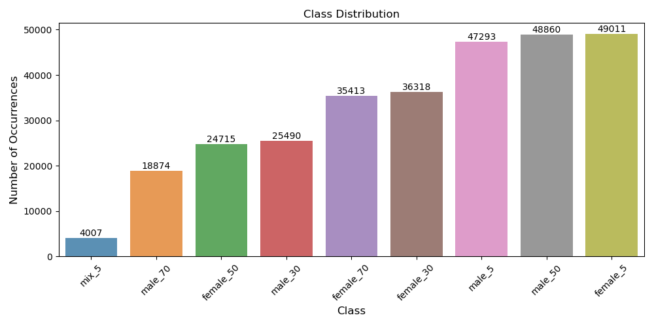
EDA
Dataset
Initiated the methodology with the Fly Atlas transcriptomics dataset (head cells only).
- Obtained raw (UMI-based data) samples from Hongjie Li Lab
Data Integrity
Checked for data integrity, ensured no duplicate rows or missing values in the gene expression data.
Data Format
Shifted data from a sparse to a dense format for easy manipulation and analysis.
Target Variable
Analysed 'sex_age' as the primary target variable, 'female_5' being the most populous category.
Also looked at ‘sex’ and ‘age’ variables
Gene Expression Data
Examined gene expression data, decided to keep identified outlier cells due to potential biological significance.
Figure 1: Bar Plot Showing Class Distributions for sex_age

Slide 4

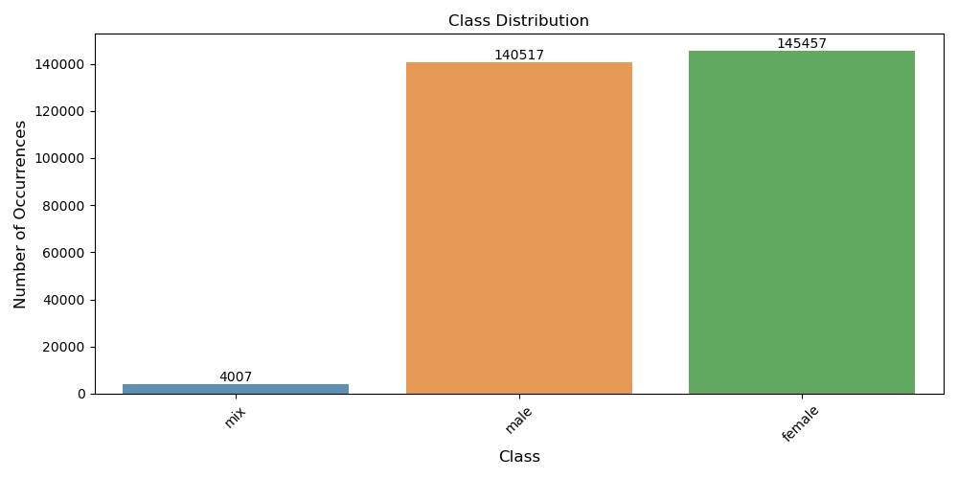
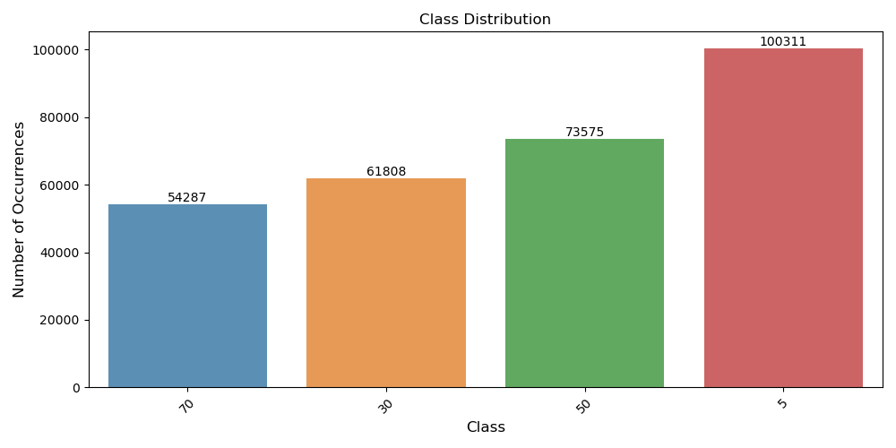
Figure 2: Bar Plot Showing Class Distributions for Sex
Figure 3: Bar Plot Showing Class Distributions for Age

Slide 5
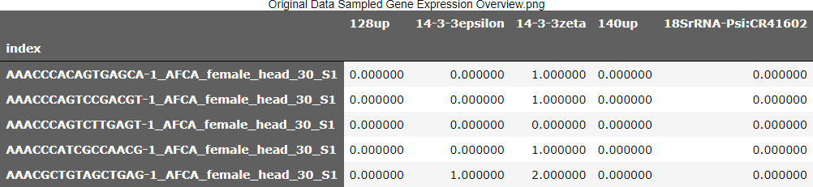
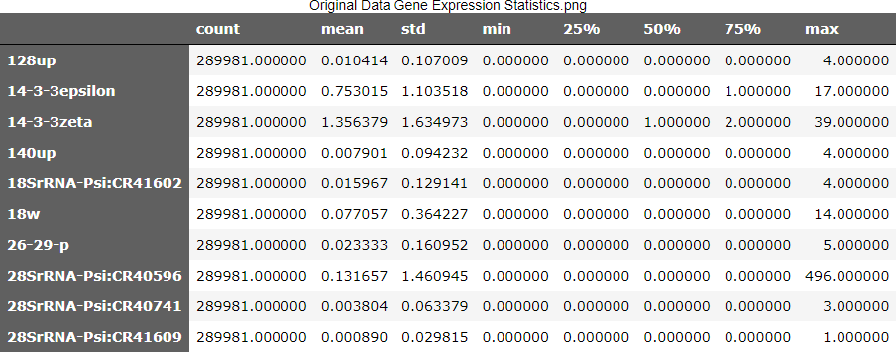
Figure 4: Gene Expression Matrix for First Five Cells
Figure 5: Statistical Summary of First 10 Genes

Slide 6
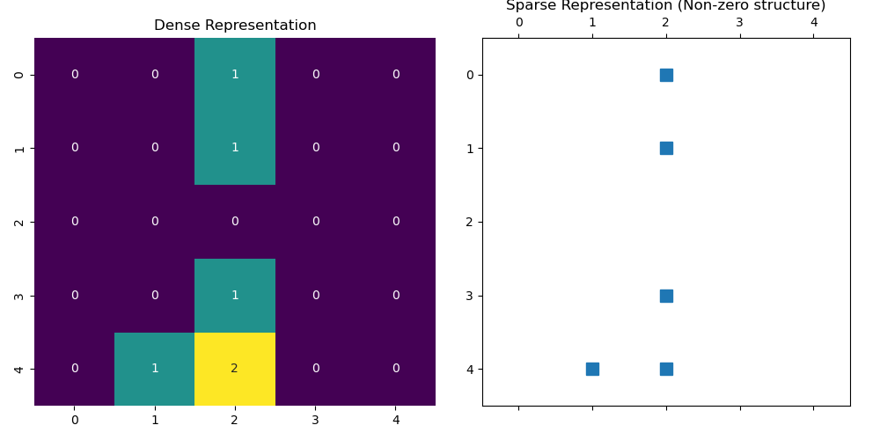
Figure 6: Dense vs Sparse Matrix Transformation Comparison
Figure 7: Observation DF Overview

Slide 7
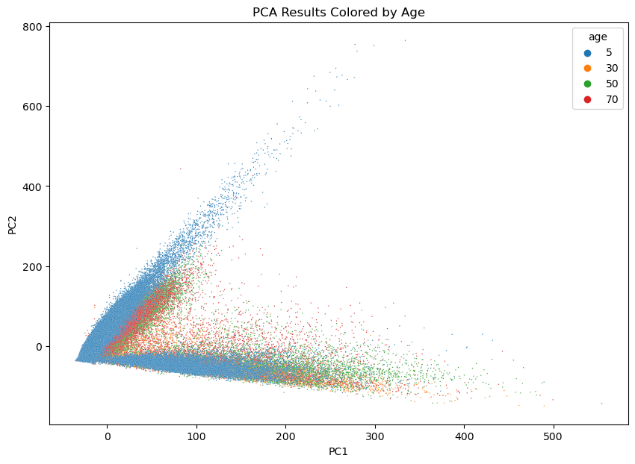
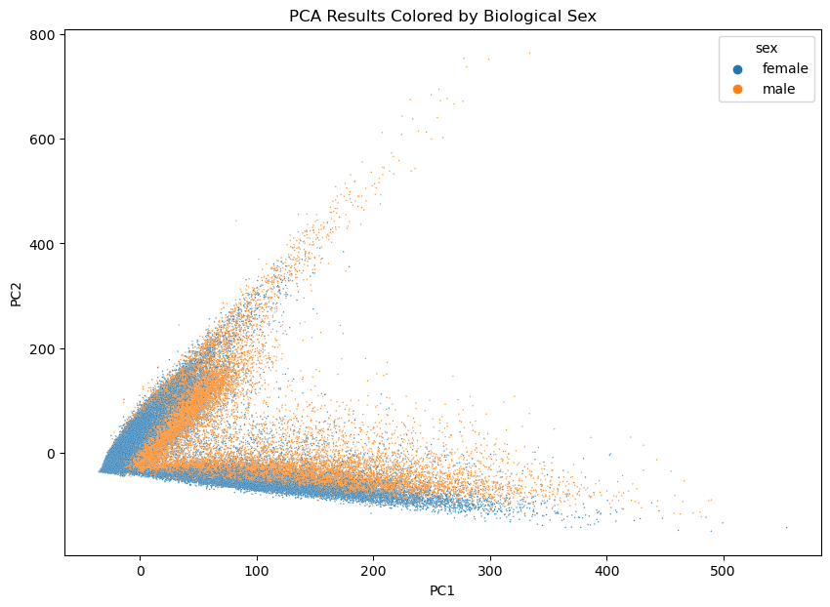
Figure 8: PCA scatter plots assessing the impact of biological sex and age on dataset variability, aimed at distinguishing significant biological patterns from noise.

Slide 8
Initial Data Split
Initial stratified split of dataset into evaluation (for pre-trained models) and larger training subsets (everything else)
Data Handling
Selective handling of categories and properties, such as 'mix' category exclusion and gene shuffling.
Further customizable by removing certain genes (for example, autosomal, non-autosomal, lnc, or any combination therfore)
Stratified Subset Selection (Skipped)
Selected a manageable stratified subset of 200,000 cells from the training dataset.
PREPROCESSING
Further Split and Transformation
Further stratified split of selected data into training and testing subsets.
Data labels transformed using a label encoder and one-hot encoding
Data Reshaping
Convert gene expression data to dense matrix and reshape to fit CNN input
Chose to bypass standardization/normalization due to performance reduction.
Data Saving and Loading
Preprocessed data, label encoder, lime explainer, standard scaler and reference data saved for potential future use.
Feature to load saved info above for subsequent pipeline executions.

Slide 9
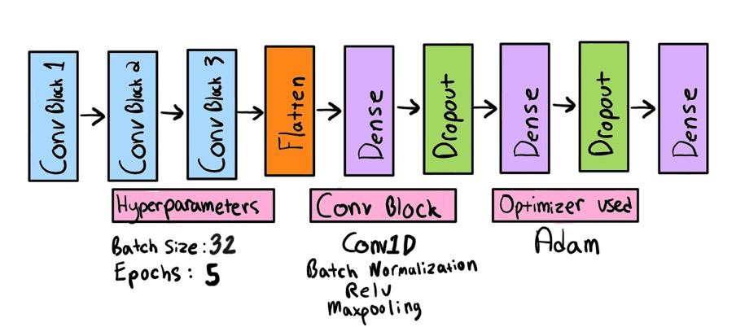
MODEL BUILDING AND TRAINING
Configurable Model Building
- Model construction guided by a flexible configuration file.
Model Construction
Three base models built: 'sex', 'age', and 'sex_age’.
Further variations built by removing certain genes (for example, autosomal, non-autosomal, lnc, or any combination)
Type: 1D CNN
Architecture: Convolutional blocks, flattening layer, fully connected layers, and output layer.
Optimization and Compilation
Models compiled using Adam optimizer and categorical cross-entropy loss function.
Evaluation metrics: accuracy and AUC.
Training Process
Incorporated validation split and custom early stopping and model checkpointing.
Checkpointing ensures retention of the most optimal model parameters and aids visualization.
Figure 9: Convolution Neural Network Architecture

Slide 10
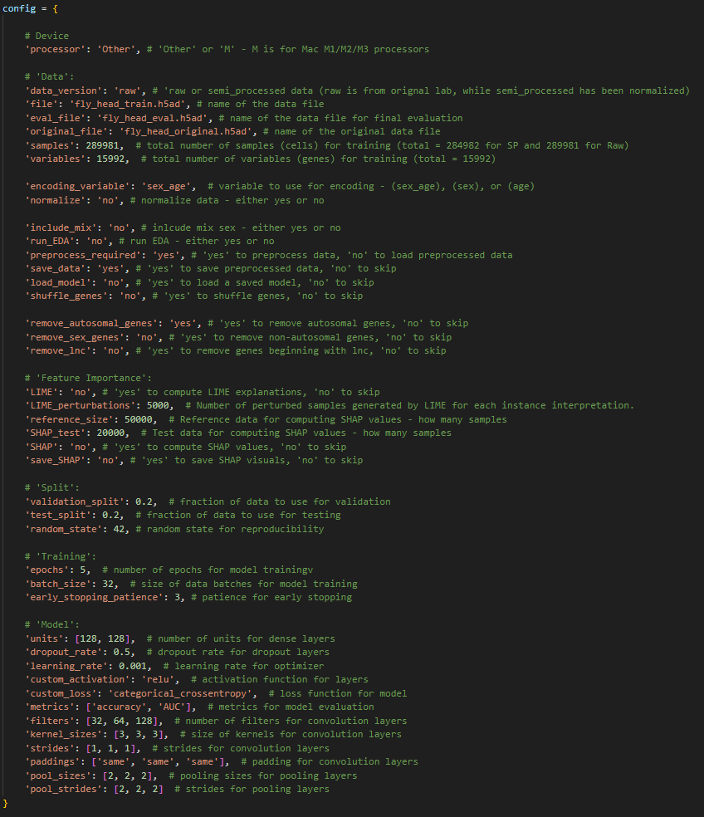
Figure 10 : Config Dictionary

Slide 11
R E S U L T S
Metrics

Slide 12

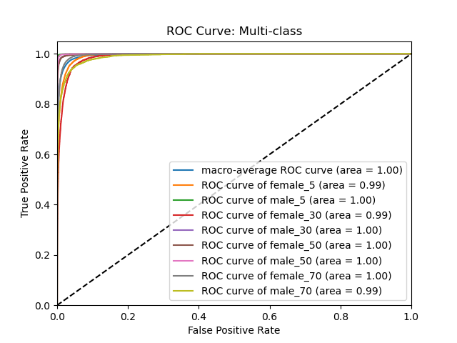
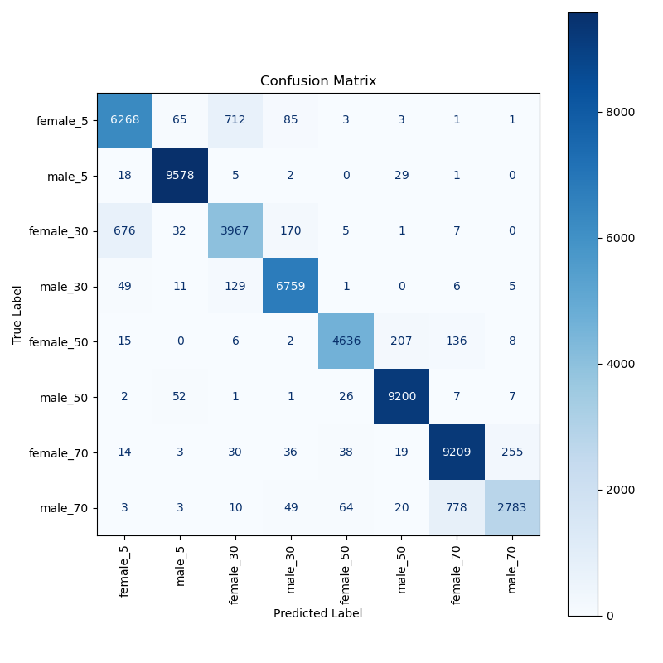
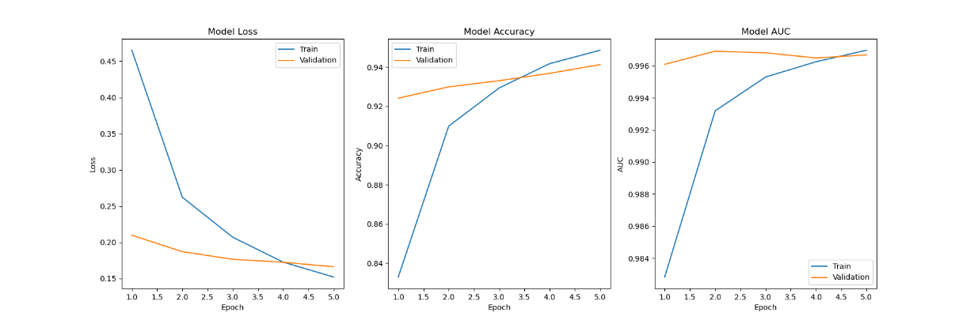
Figure 11: sex_age ROC Curve
Figure 13: sex_age Confusion Matrix
SEX AGE
Figure 12: sex_age Training History Plot

Slide 13

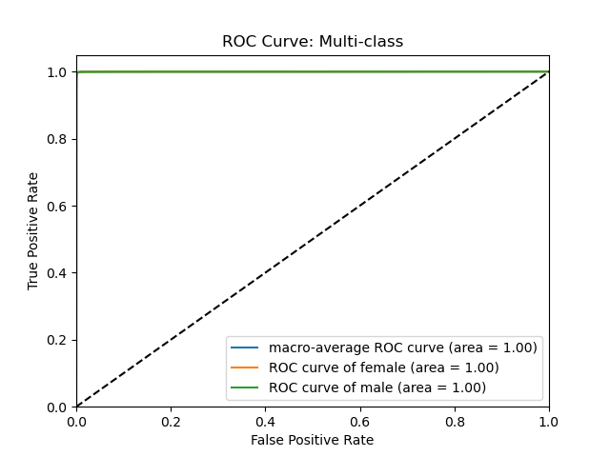
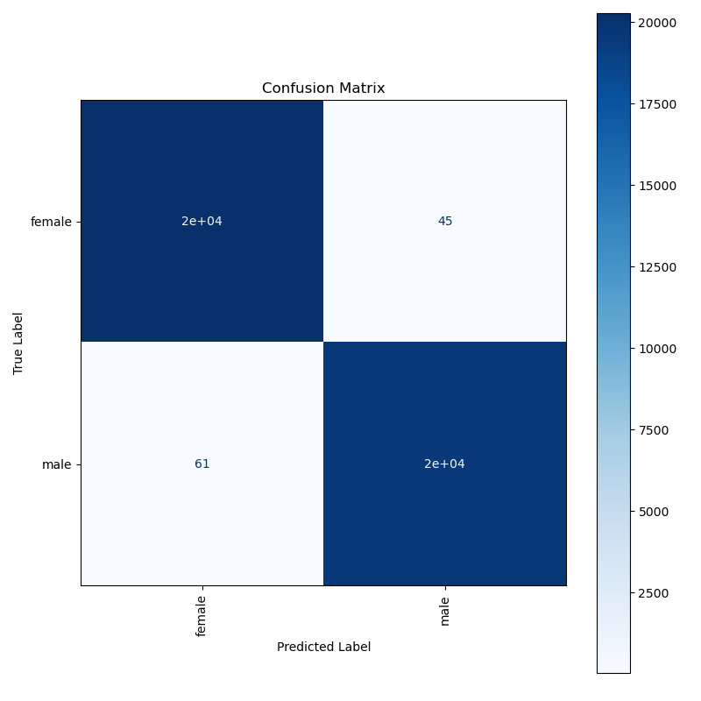
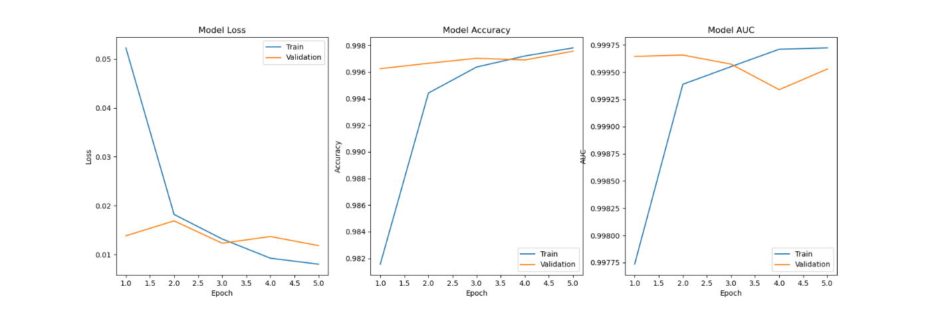
Figure 14: Sex ROC Curve
Figure 16: Sex Confusion Matrix
SEX
Figure 15: Sex Training History Plot

Slide 14

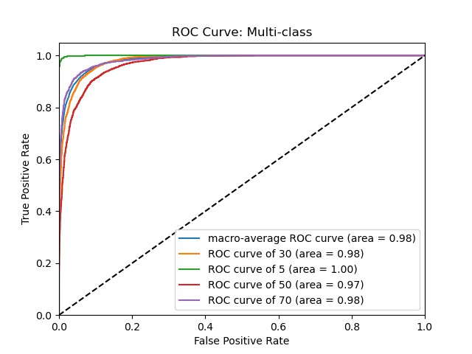
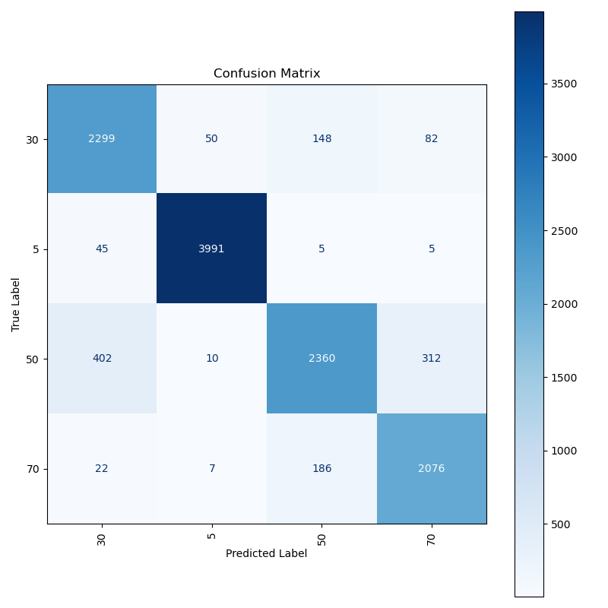
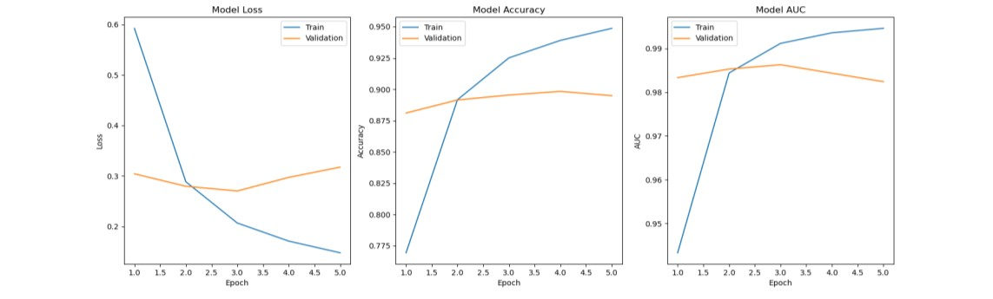
Figure 17: Age ROC Curve
Figure 19: Age Confusion Matrix
AGE
Figure 18: Age Training History Plot

Slide 15
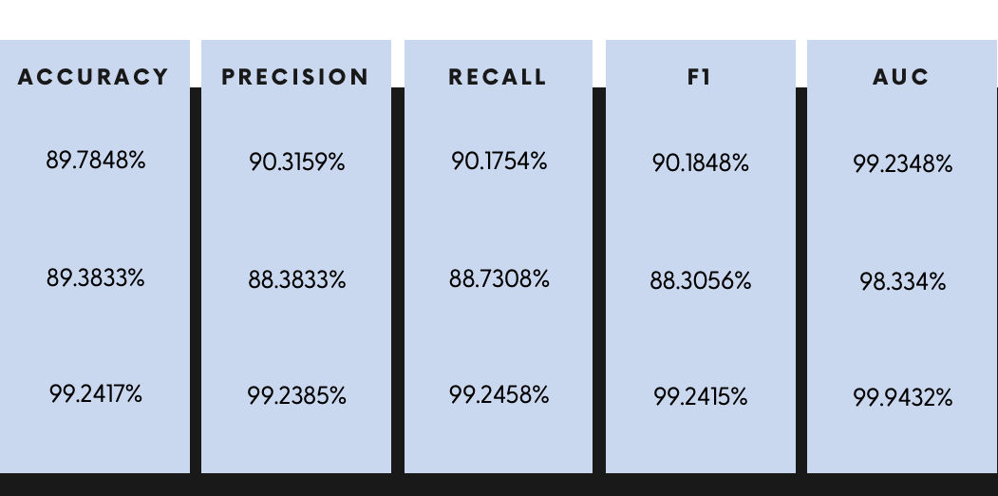
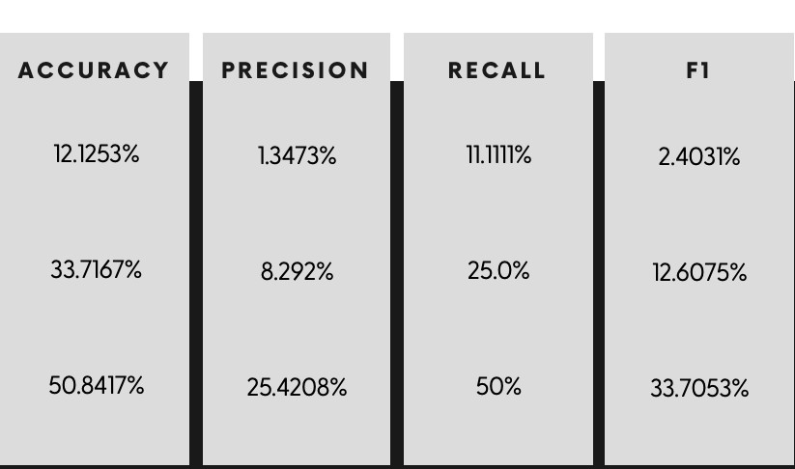
TRAINED MODELS (1D CNN)
BASELINE
(Majority Classifier)
SEX
_AGE | 94% |  | 93% |  | 93% |  | 93% |  | 99.65%
AGE | 94% |  | 94% |  | 94% |  | 94% |  | 99.44%
SEX | 99.7% |  | 99.7% |  | 99.7% |  | 99.7% |  | 99.97%
17.14% |  | 2.14% |  | 12.50% |  | 3.66%
33.67% |  | 8.42% |  | 25% |  | 12.5%
50.87% |  | 25.44% |  | 50% |  | 33.72%
SEX_AGE
AGE
SEX

Slide 16
BASELINE
(Comparable Models)
XGBOOST
87%
51%
94%
86%
53%
93%
83%
39%
92%
84%
31%
93%
98.6%
90%
99.58%
Random Forest
MLP

Slide 17
R E S U L T S
Feature Importance

Slide 18
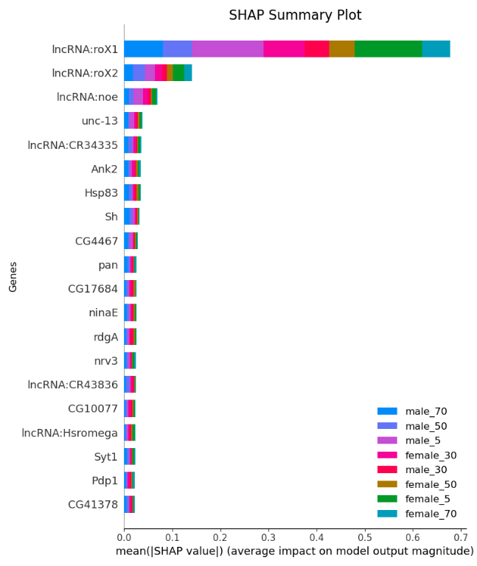
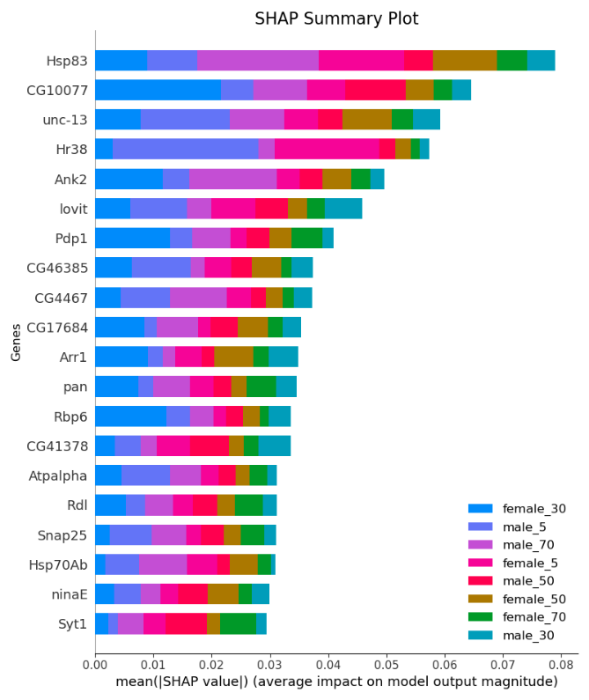
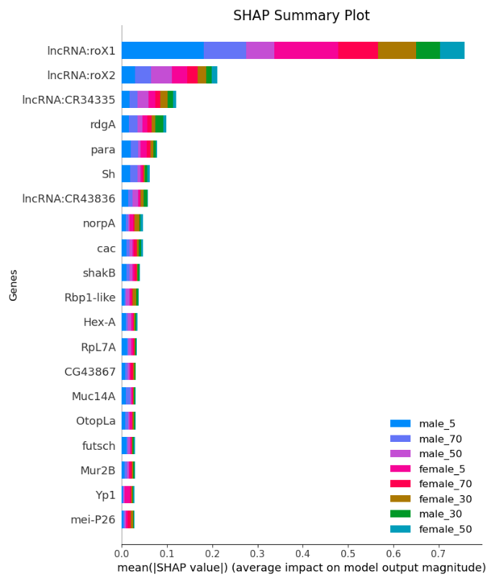
SEX AGE
Figure 20 : Sex_Age SHAP Summary Plot – All Genes (ACC: 94%)
Figure 21 : Sex_Age SHAP Summary Plot – Only Autosomal Genes (ACC: 85%)
Figure 22 : Sex_Age SHAP Summary Plot – Only lnc and non-austosomal Genes (ACC: 78%)

Slide 19
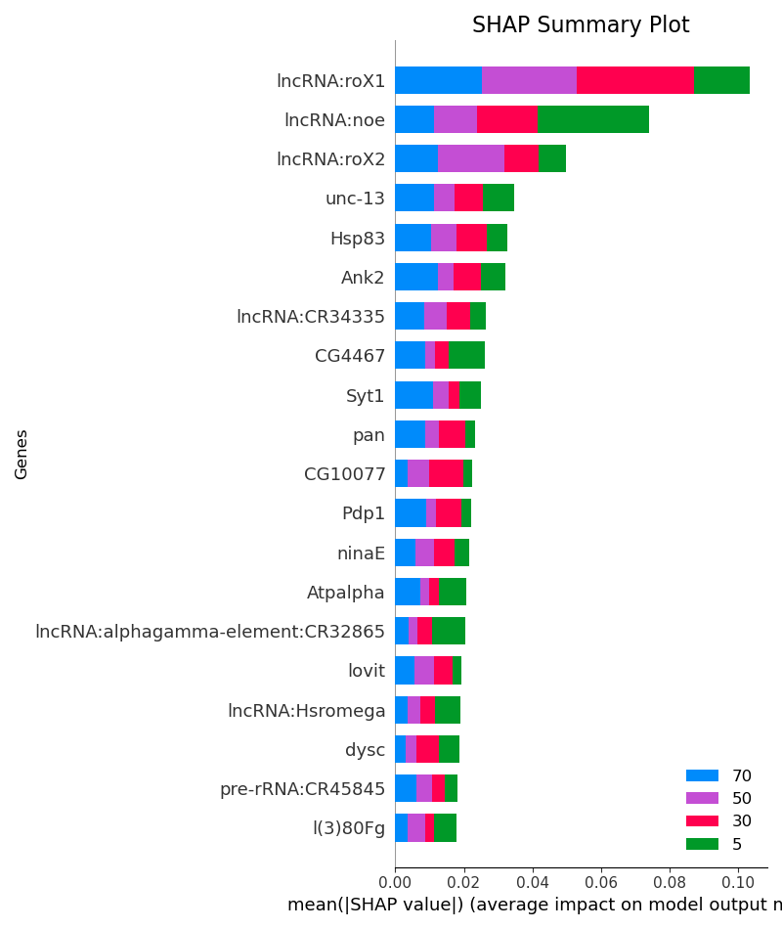
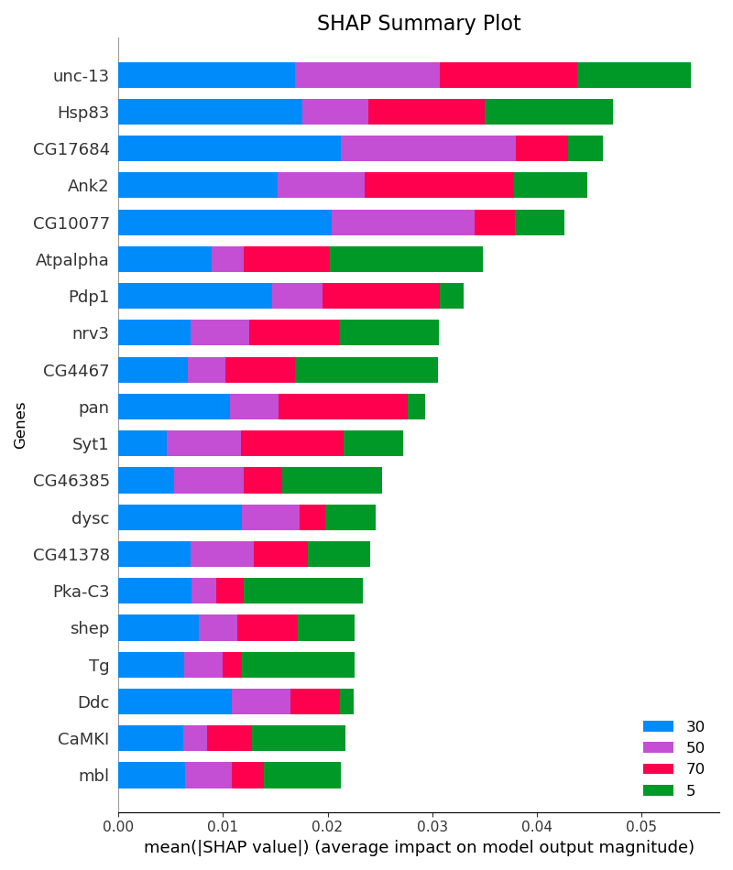
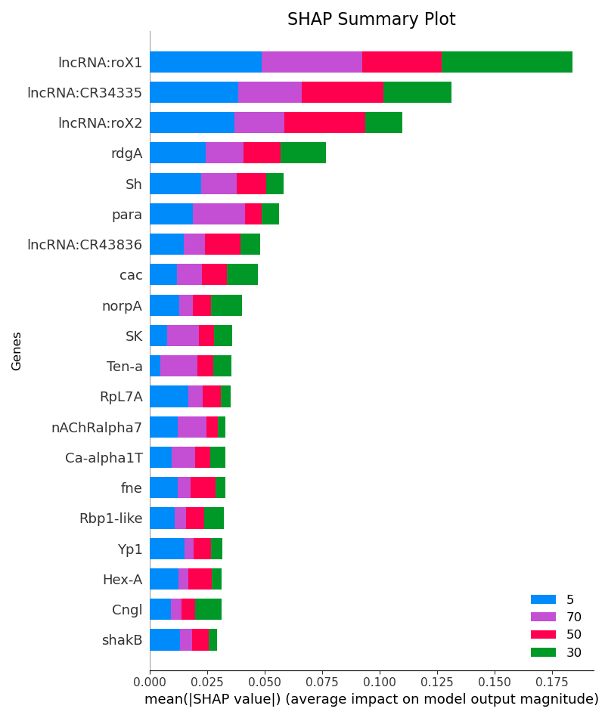
AGE
Figure 23 : Age SHAP Summary Plot – All Genes (ACC: 94%)
Figure 24 : Age SHAP Summary Plot – Only Autosomal Genes (ACC: 90%)
Figure 25 : Age SHAP Summary Plot – Only lnc and non-austosomal Genes (ACC: 80%)

Slide 20
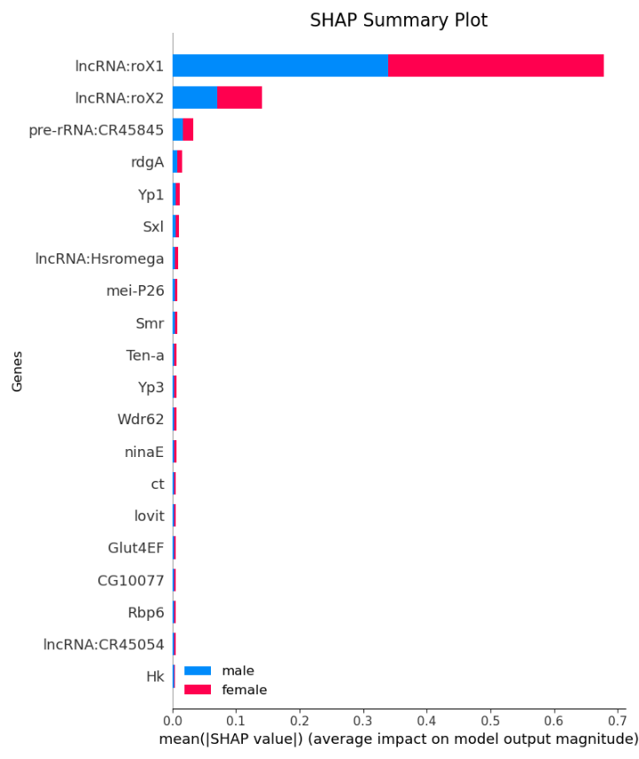
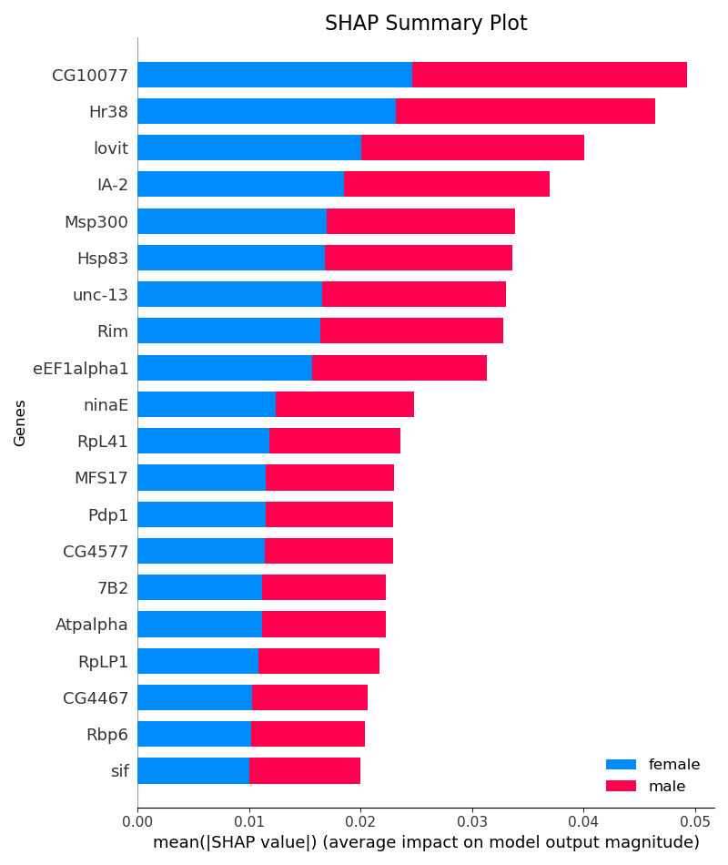
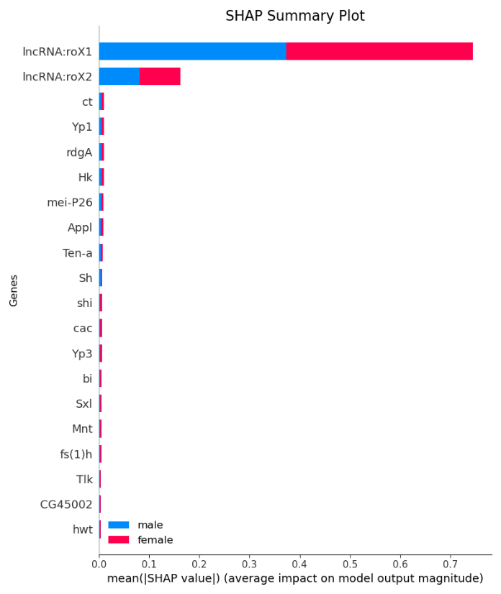
SEX
Figure 26 : Sex SHAP Summary Plot – All Genes (ACC: 99.72%)
Figure 27 : Sex SHAP Summary Plot – Only Autosomal Genes (ACC: 88%)
Figure 28 : Sex SHAP Summary Plot – Only lnc and non-austosomal Genes (ACC: 99.78%)

Slide 21
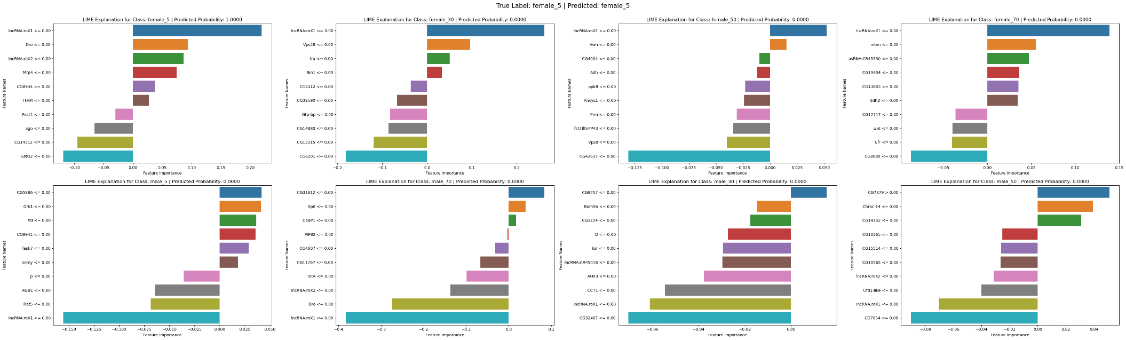
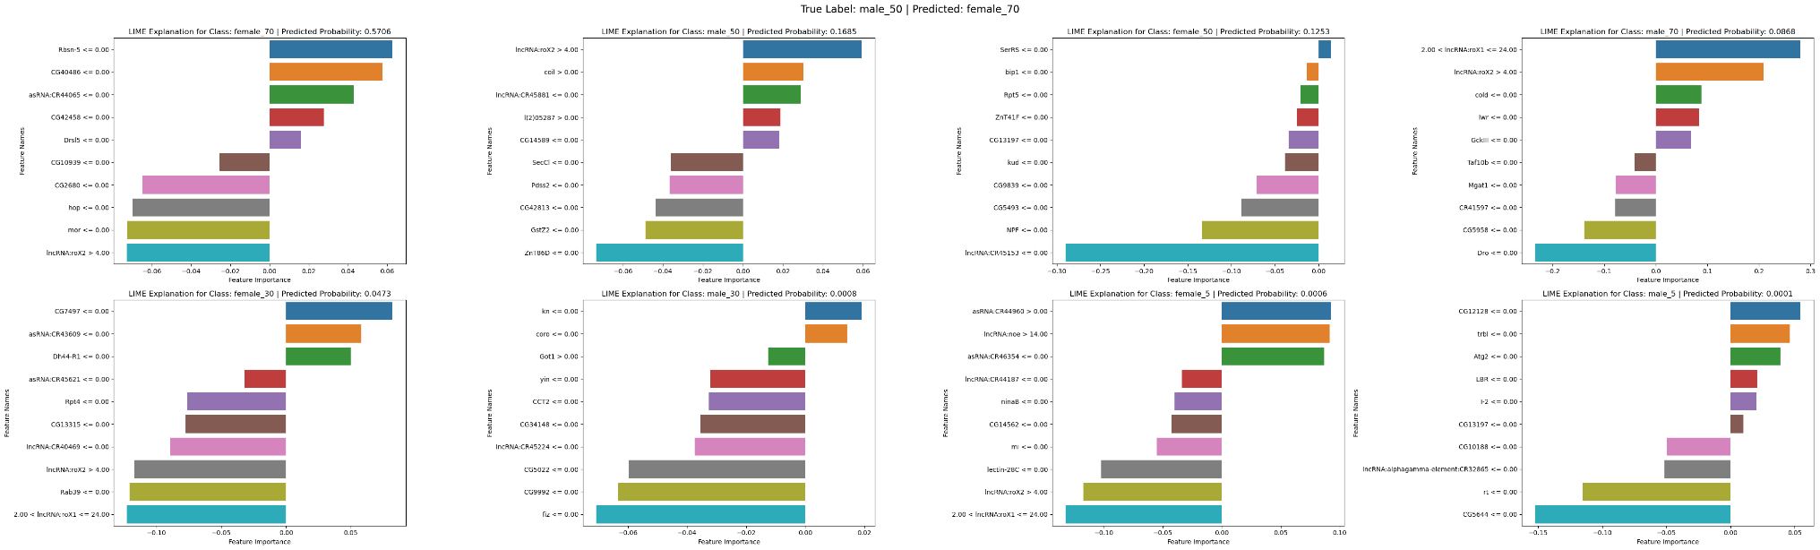
Figures 29: LIME Explanations for SEX_AGE (T: correct, B: incorrect)

Slide 22
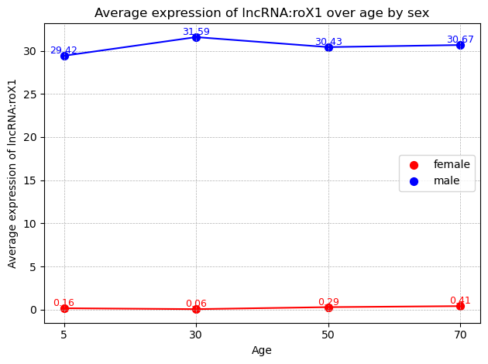
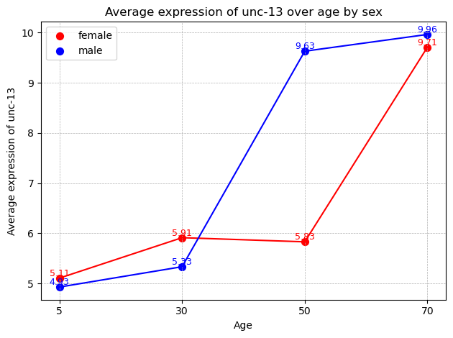
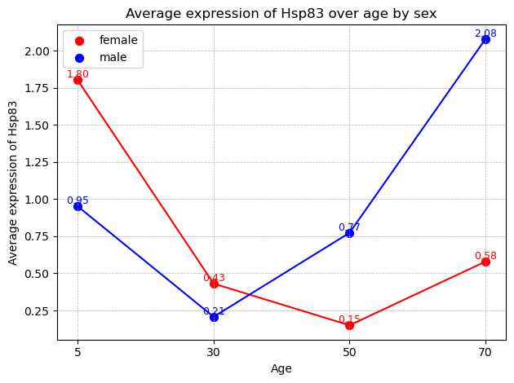
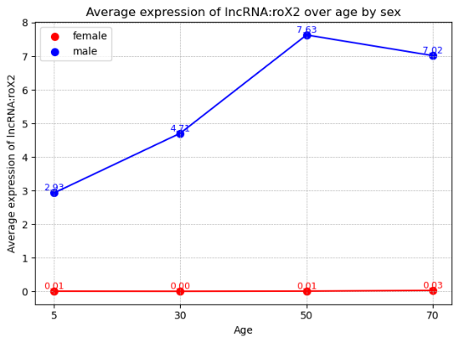
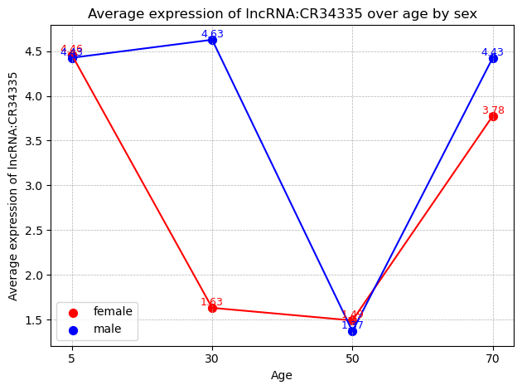
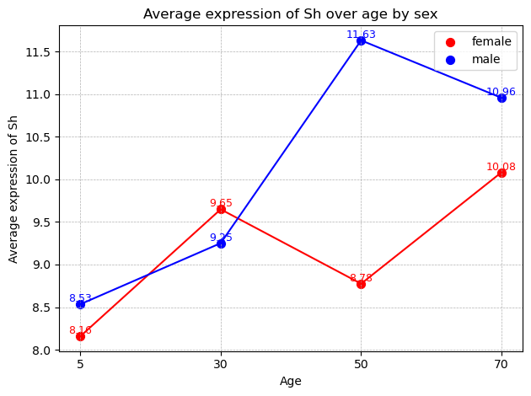
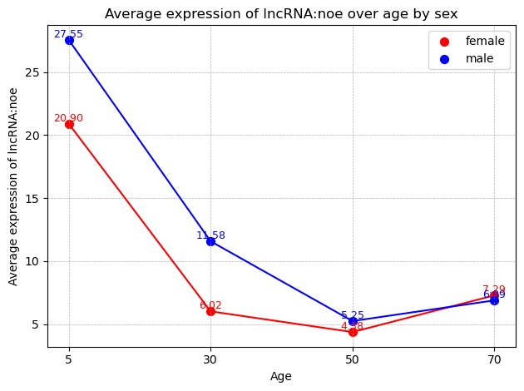
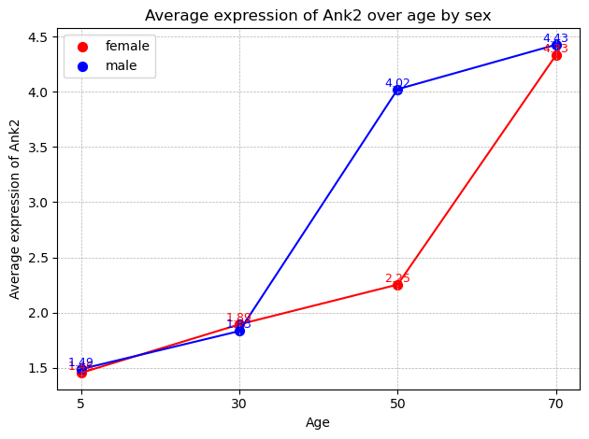
Figure 30: Differential expression of the top 20 SHAP-identified features (from SEX_AGE) across age groups by sex.

Slide 23
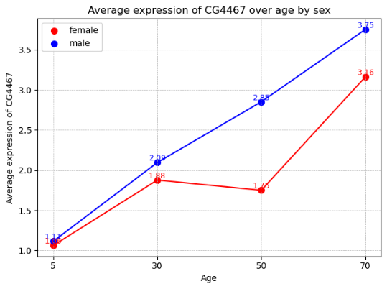
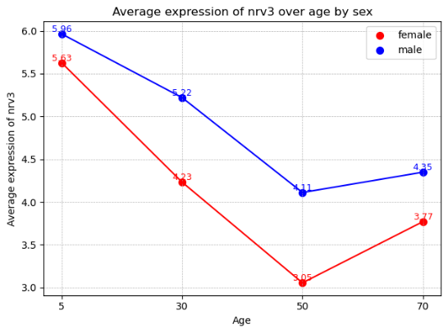
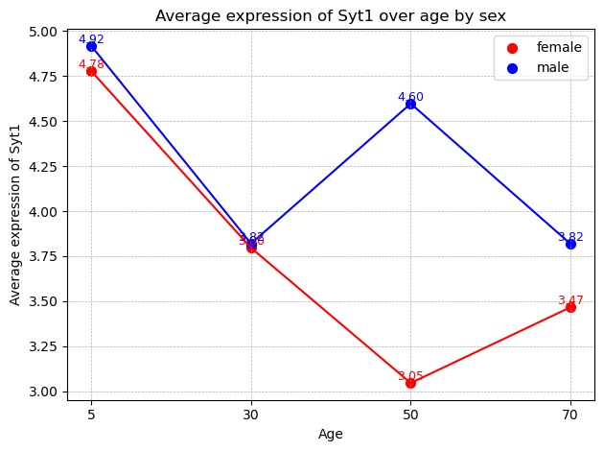
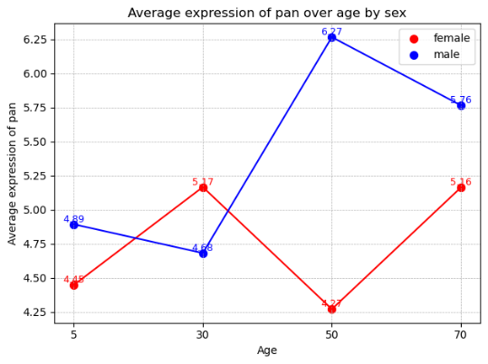
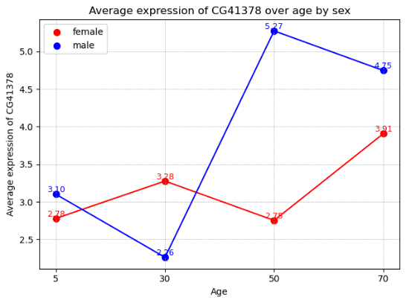
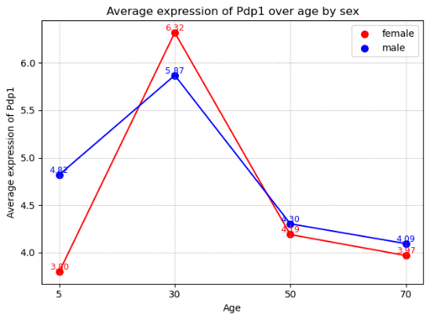
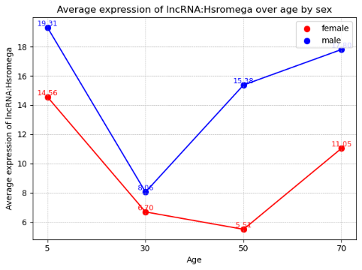
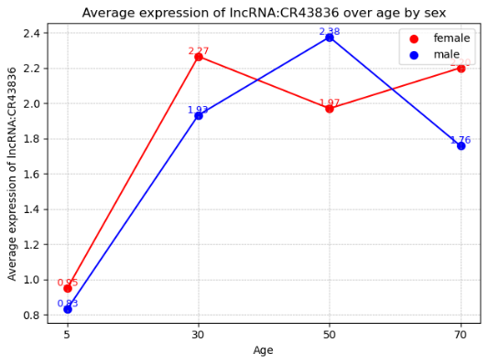





Slide 24



NEXT STEPS
Further Genomic Analysis
To discern the roles of key genes in sexual dimorphisms and ageing in flies, it's essential to delve into existing literature, analyse biological functions using tools like GO or KEGG, validate findings through lab experiments, and collaborate with genetics and fly biology experts.
Diversified Datasets
Aim to apply the model to a wider range of datasets collected by IISAGE.
Scientific Publication
Prepare a paper detailing the results and analysis for peer-reviewed publication.

Slide 25

PRIOR WORKS AND METHODS
Tzu-Chiao Lu et al.: Provided the raw UMI data.
López-Otín et al.: Detailed the biological processes associated with aging.
Bronikowski et al.: Provided a comprehensive perspective on sex-specific ageing.

Slide 26


CONCLUSION
Key Points
Developed a powerful pipeline to analyse high-dimensional genomics data.
Deep learning-based 1D CNN model effectively recognized intricate data patterns, enabling precise predictions about sex and age from gene expression profiles.
Feature Importance gives insight into which genes are most important.
Insights generated will enhance understanding of sex-specific aging biology and underscore the efficacy of deep learning in genomics.
Project Materials
All project materials including code, onboarding, lab materials and deliverables can be found on the Singh Lab GitHub (Branch:
Nikolai’s-CNN).

